Slide 1
RFID BASED AUTO-GATE SYSTEM
GROUP B: SARAH NAWOYA
MUTONI BRICE QUERCY
HALIMA MOHAMED

Slide 3
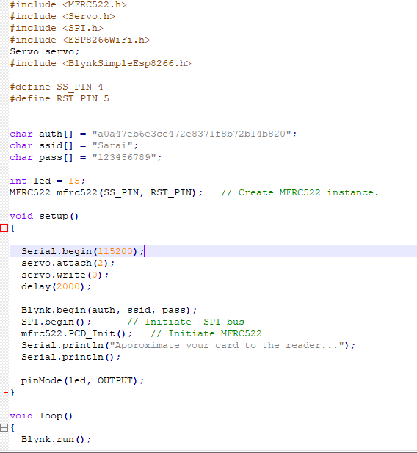
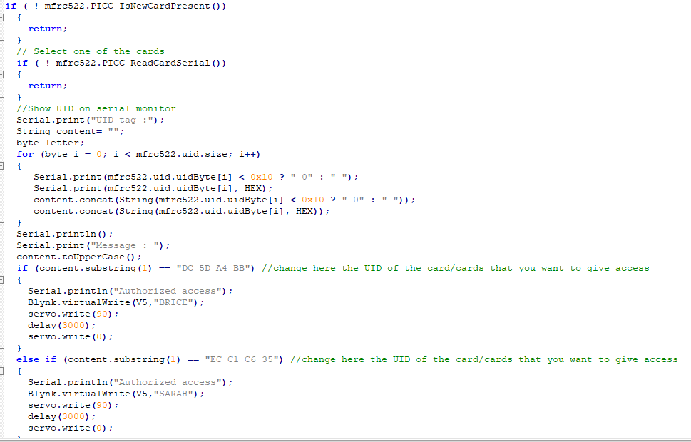

Slide 4
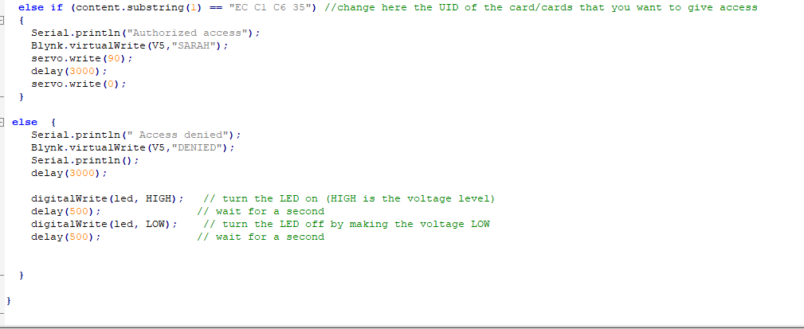

Slide 5
Slide Title

Slide 6
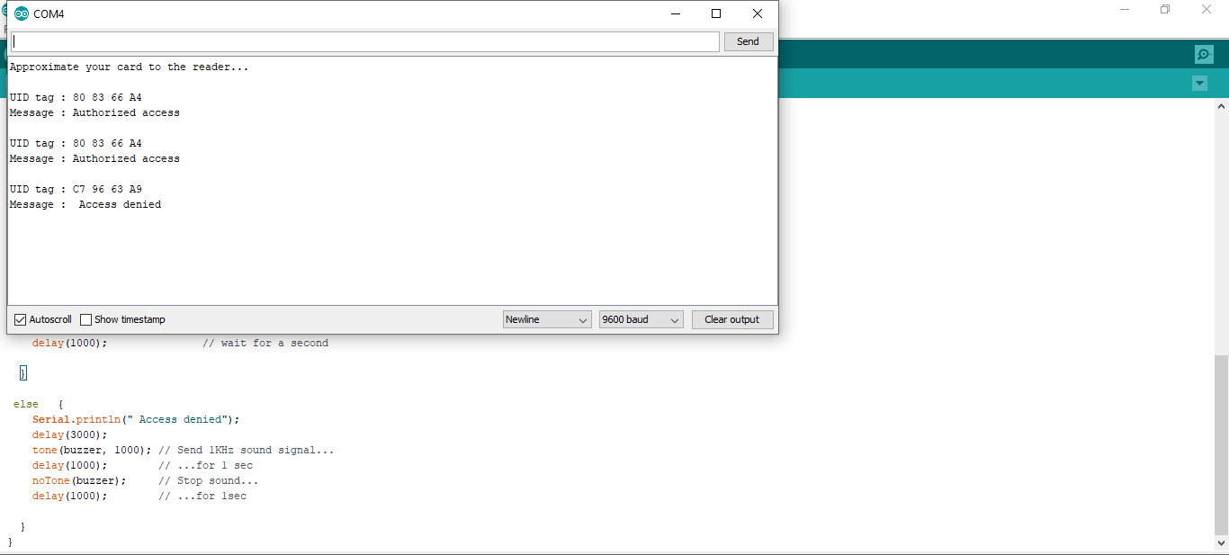

Slide 7
THANK YOU

